Slide 1

Annual General Meeting
2023 - 2024

Slide 2
Annual General Meeting - 23/24
Housekeeping
Welcome & Apologies
Health & Safety
Signing in sheet

Slide 3
Annual General Meeting - 23/24
Agenda
Reflecting on the year
Treasury Overview
Message from Mrs Wand
Message from Mrs Reeve
Message from the Chair
Who’s Who 2024
Key dates
Q & A , Any other business

Slide 4
Annual General Meeting - 23/24
Reflecting On The Year – THANK YOU
THANK YOU to:
The great PTA team
Our fantastic volunteers inc. children
Our awesome teacher & school staff
Local businesses
The amazing community
The fabulous event organisers

Slide 5
Annual General Meeting - 23/24
Reflecting On The Year – MONEY WELL SPENT
*Reminder* at 22/23 AGM, PTA reported £41k for schools to spend.
(£21k carried over from previous years + £20k new income.)
The Village School:
World book day activities
Phonics & classroom books
Christmas Pantomime
The Junior School:
Chromebooks
Headphone/microphone
Electric Keyboard
Whiteboard
Christmas Pantomime
PTA:
Strong Gazebos
Shed Storage

Slide 6

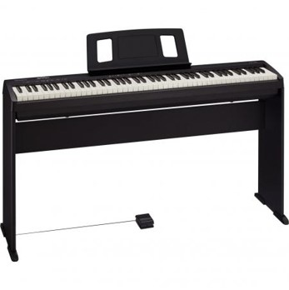
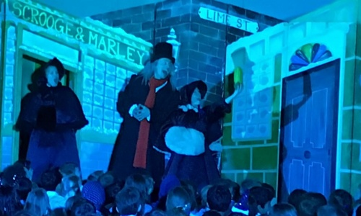



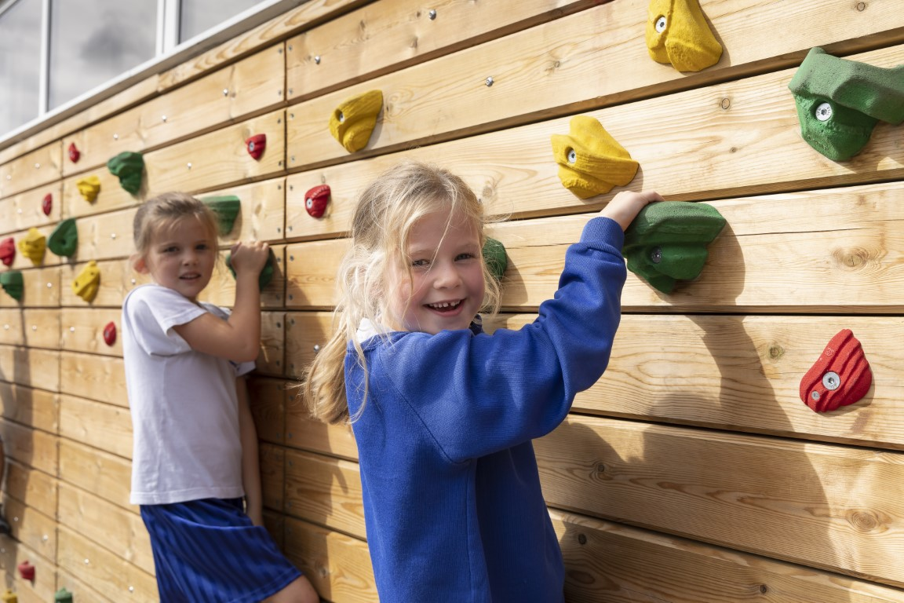
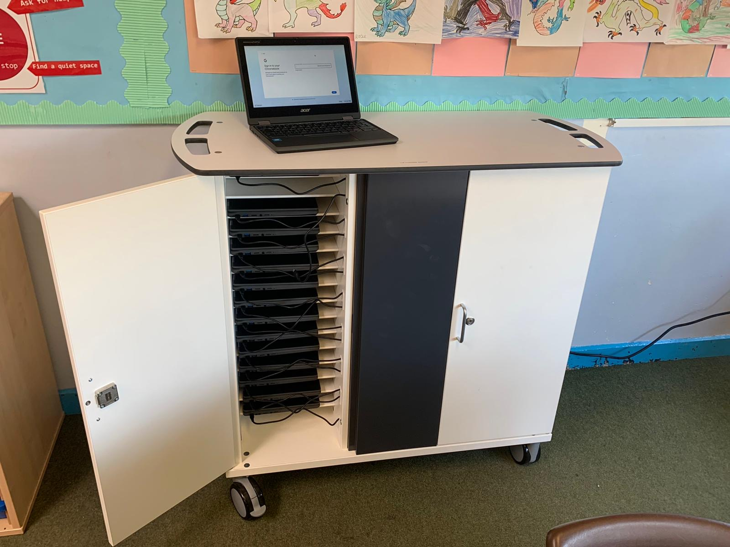
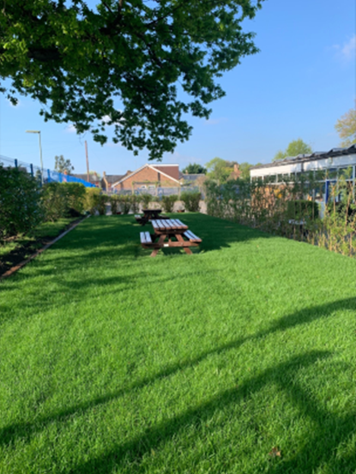
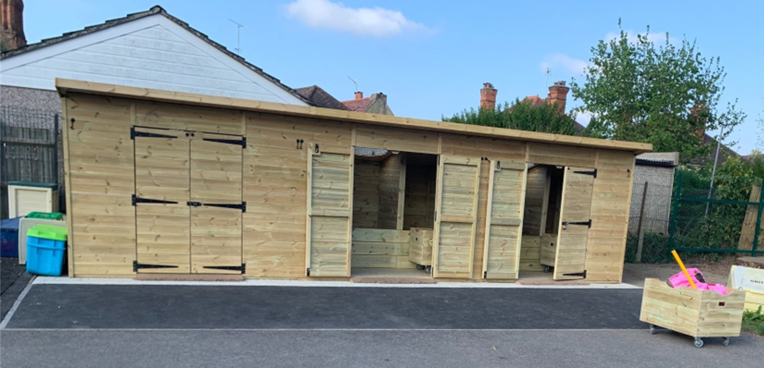

Slide 7

















Annual General Meeting - 23/24
Reflecting On The Year – FUNDRAISING EFFORTS
ITS BEEN A BUSY YEAR…

Slide 8
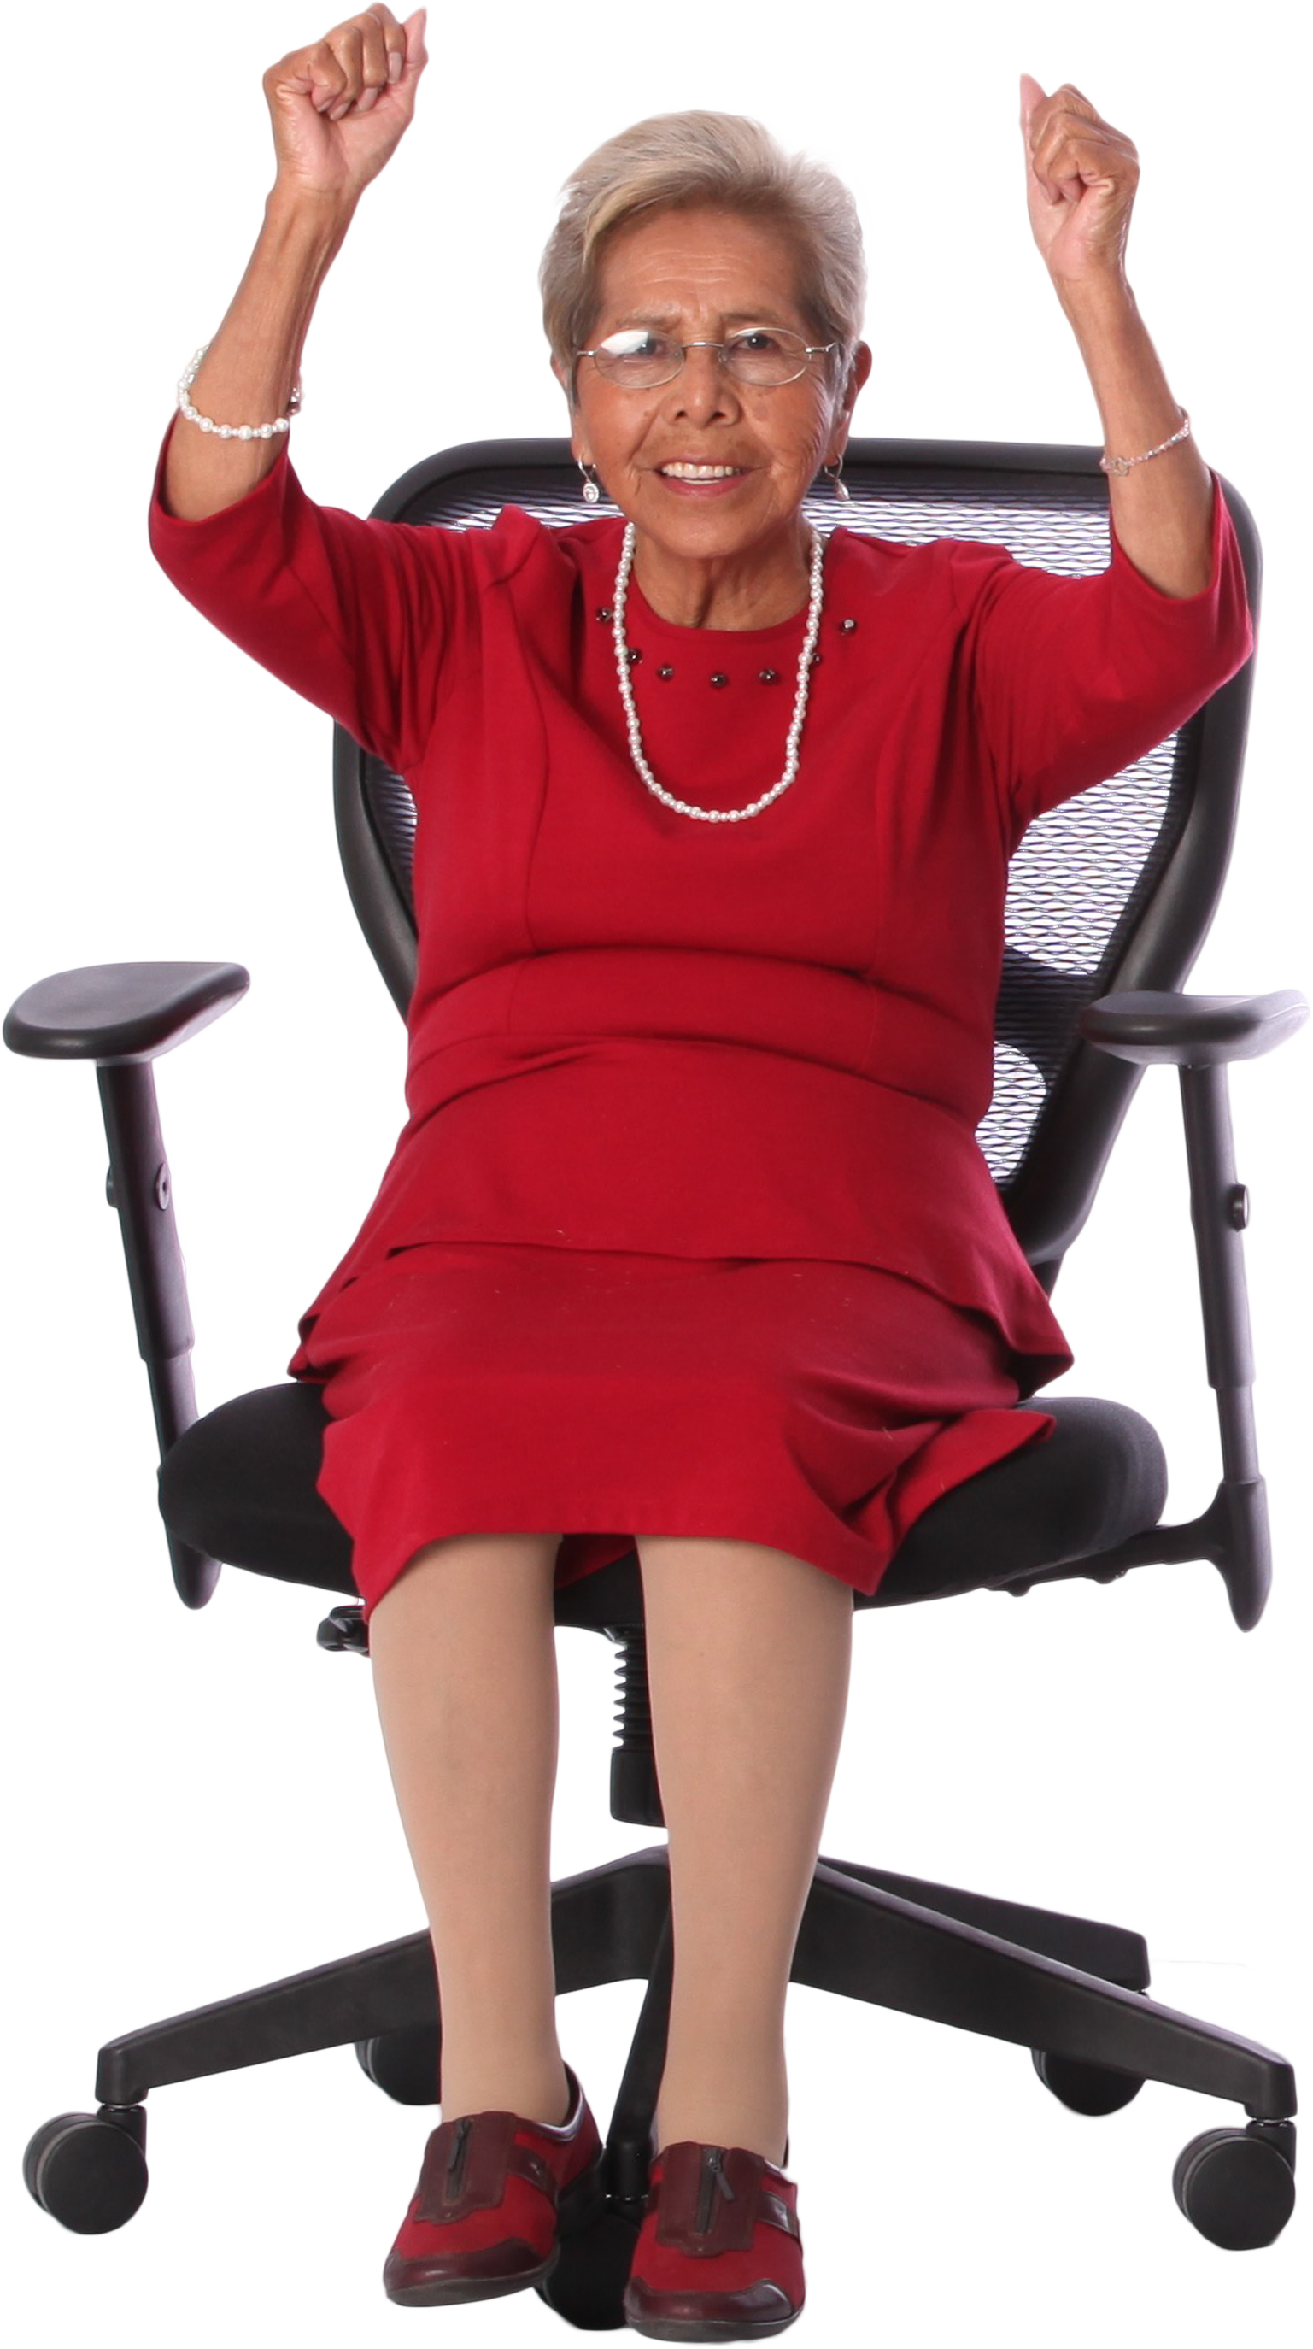
Annual General Meeting - 23/24
Reflecting On The Year – HOW DID WE DO?
OUR TARGET WAS £25K
WE RAISED…
£24’900

Slide 9
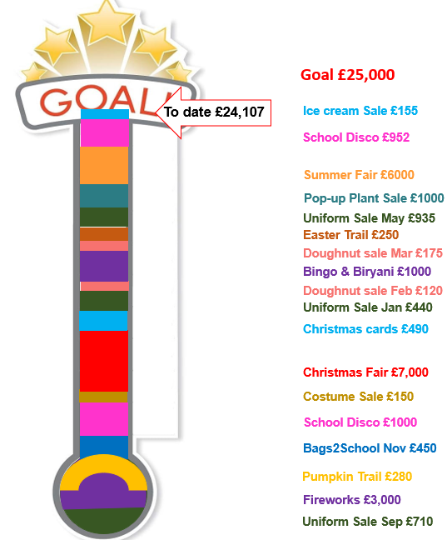

Slide 10
Annual General Meeting - 23/24
A Message From The TREASURER
£39K in PTA funds for schools:
  (<£25k income PLUS £14k carried over)
25% increase on funds raised
£26k spent last year
New Sumup machines
Gazebos and Shed

Slide 11

Annual General Meeting - 23/24
A Message From MRS WAND
Horsell C of E Junior School
PTA Donations | £
White board Spruce | £3,288.00
Panto Dec 23 | £1,199.00
Party packs Xmas Dec 23 | £173.47
Keyboard | £430.99
White board | £2,865.83
Chromebook donation | £2,500.00
4 Wireless Microphones/headsets (Children’s productions & assemblies) | £106.64
2 Wireless Microphones hand held (Children’s productions & assemblies ) | £46.66
30 Chrome Books YR3 | £9,345.00
Received with thanks | £19,955.59

Slide 12

Annual General Meeting - 23/24
A Message From MRS REEVE

Slide 13

Annual General Meeting - 23/24
Plans for Next Year – DELIVERABLES
The Village School:
Replacing classroom & library books
Well-being equipment for children
Christmas pantomime
The Junior School:
New production stage
60 more Chromebooks
Contribution towards a sandpit for OPAL play
Christmas pantomime
PTA:
Strong Gazebos
Shed Storage

Slide 14
Annual General Meeting - 23/24
Plans for Next Year - COMMUNITY
Continuation of loved events
Introduction of new events (Costume run, car boot sale)
More adult events, make friends
Surprise in Summer (maybe a Circus)
Christmas cards from the children

Slide 15
Annual General Meeting - 23/24
Plans for Next Year – IMPACT OF YOUR VOLUNTEERING
1 Biff, Chip & Kipper book = £4
Cakes & refreshments at SF took = £240
Taking per ½ hours = £40
40÷4 = 10 Biff, Chip & Kipper books = every half hour of your time
60 books across 2 year groups = 60 children accessing the same book at one time
60 Chomebooks @ £150 = £9000 = whole Christmas Fair taking plus more
This will allow each year group to have access to 30 Chomebooks at one time
The fun, the laughter – that’s priceless!

Slide 16
Annual General Meeting - 23/24
Plans for Next Year – WAYS TO GET INVOLVED
Help at events – i.e. fireworks, fairs, end of term treats
Be part of the community – attend events, buy raffles tickets, do the trails, spread the word, get children involved
Run, arrange & attend social/fundraising events
Vacancies: Deputy Secretary, Deputy Chair - be part of the steering group

Slide 17
Annual General Meeting - 23/24
Who’s Who September 2024
Vacancies are in red & (V), please contact your class rep or email horsellschoolspta@gmail.com
Core Roles
Treasurer
Emma Machin
Chair (V)
Sima Huddy
Secretary (V)
Jenny Dutfield
Communication Team
Class Reps Co-ordinator
Becky Scholes
PTA Web page & HM author
Sarah Taylor
Junior School Liaison
Helene Opshal Gordon
Village School Liaison
Naomi/Stephanie
Event Leads
School Disco (V)
Emma C, Emily H & Michelle H
Uniform Sales
Becky Scholes (V)
Fireworks ‘24
Andy J & Peter C
Bingo & Quiz
Dee Bamra
Christmas Fair ‘24
Sara Gomm
Summer Fair ‘25
Vacant
Events Support Team
Sponsor & Raffle Lead
Vacant
Volunteers Co-ordinator
Sima/Per event
Ops & Risk Assessment
Anna Bourne
Jolly Jars
Louise Ellis
Fundraising Initiatives
Bags2School
Louise Ellis & Timea Lodge
Christmas Cards
Helene Gordon
End of term Treat
Termly volunteers
(Vacant)
Easter & Pumpkin Trail
Sima Huddy
Plant sale
Sam Byrne

Slide 18
Annual General Meeting - 23/24
Key Dates for Your Diary
October 2024 Thu 24th Family Fireworks Mon 28th – Sat 9th Nov Pumpkin trail | November 2024 Fri 8th Bags2School Fri 15th School Disco (HJS only) Fri 22nd Mufti donations *please sign up to help | December 2024 Sat 7th Christmas Fair *please sign up to help
January 2025 Sat 25th Good as new Uniform sale TBC: Volunteers’ Social | February 2025 Fri 28th: Quiz night TBC: Car Boot Sale | March 2025 29th Mar– 13th Apr – Easter Trail
April 2025 Fri 4th Doughnut sale Fri 25th (TBC) Bags2School TBC: Bingo & Biriyani | May 2025 Sat 17th Good as new Uniform sale TBC: Plant sale | June 2025 TBC: Mufti day July 2025 Sat 5th Summer Fair End of year Disco Tue 22nd Ice cream sale

Slide 19
Annual General Meeting - 23/24
Q&A
AOB

Slide 20
Annual General Meeting - 23/24
THANK YOU

