Slide 1
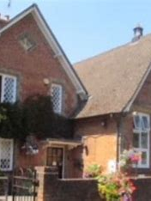
Year 2 Parents Induction Meeting
2024

Slide 2

The Vision for our School
That our children will be happy, secure and confident individuals that ask questions, challenge thinking and are motivated to learn. We will see active and engaged learners, experiencing a first-class education with a high achievement culture. Having Enquiry and Investigation and The Arts at the heart of the curriculum, we ensure that the children have constant opportunities to investigate and apply their knowledge, take risks and responding positively to challenge.
Quality teaching and provision will ensure that all children are inspired, engaged and motivated through purposeful learning and equipped with the skills to continue as life-long learners.
We have a ‘can do’ philosophy with adults and children, the cup is always half full not half empty. As adults we model this through everything we do, what we say and the way we act.
Kindness to yourself Kindness to others Kindness to the world

Slide 3
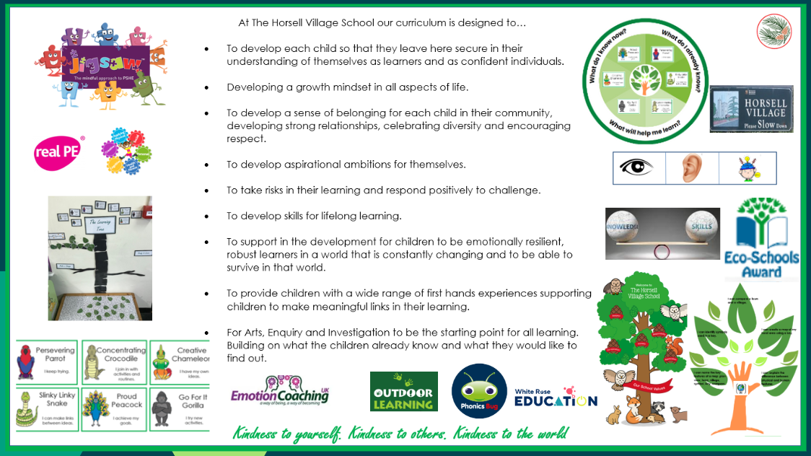
Curriculum Intent
Kindness to yourself Kindness to others Kindness to the world

Slide 4

School Values
Our values are as follows:
Respect- Respect self, fellow pupils, teachers and other adults. Respect their own and others property. Respect the right that everyone can have their own thoughts, values and opinions.
Honesty- Be truthful to ourselves and others.
Co-operation – collaborate with our peers to gain the most from our learning, to learn from each other and utilising everyone’s skills.
Appreciation-to learn to build positive relationships with others by developing effective communication, trust and to understand the worth, quality and importance of something or someone.
Responsibility - To develop a sense of community, knowing that actions have an impact on them and others.
Kindness to yourself Kindness to others Kindness to the world

Slide 5
Independence
Our focus in Year 2 is to continue to provide opportunities for the children to develop their independence. The children will be taking further responsibility for themselves, their belongings and their learning.
You can support this by encouraging them to take responsibility at home and organising what they need to bring into school every day.
Kindness to yourself Kindness to others Kindness to the world

Slide 6
Uniform Expectations
We strive to encourage the children to be as proud of the school community as we are.
To support this, we expect the children to come to school fully equipped for a day of learning.
Please make sure that they are wearing the correct uniform and that everything is clearly labelled.
Children are expected to bring their book bag to school every day.
On rare occasions, there are perfectly valid reasons for why your child may not come to school in the correct uniform, please inform us. However, if this continues, you will receive a slip from the class teacher, followed by Mrs Reeve or Mrs Sharkey.
Kindness to yourself Kindness to others Kindness to the world

Slide 7
Things to Remember
-A waterproof jacket must be in school every day regardless of the weather and a coat for winter months (hats/gloves for winter and sunhats and sun cream for spring/summer).
PE days:
Snowy Owls – Wednesday and Thursday
Tawny Owls – Wednesday and Friday
Barn Owls - Tuesday and Wednesday
Forest school:
Email has been sent with the dates
-Fruit and a filled water bottle every day.
-Reading book/s and Reading record
Kindness to yourself Kindness to others Kindness to the world

Slide 8
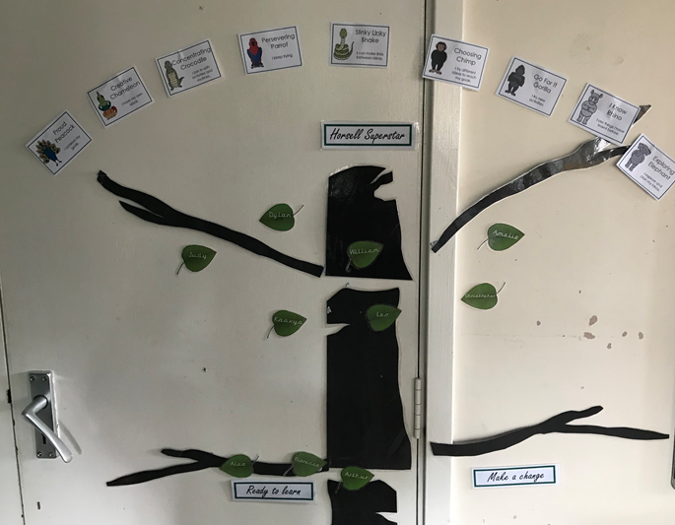
The Learning Tree
The learning tree is based around behaviours for learning as well as supporting children to identify when they are ready to learn.
Alongside the learning tree we teach the children a range of self-regulation skills which enables them to be emotionally ready to learn.
Children start the day off the tree and place their leaf on the ‘Ready to learn’ branch when they identify themselves as emotionally ready to learn.
Individual support is provided and tailored to each child throughout the day if children identify themselves as not ready to learn.
Make a change branch is a discussion point for behaviours that are not
appropriate. At this stage adults use emotion coaching to identify the issue
and provide structured support to enable the child the time to self
regulate and return to ready to learn. Children can self-select to move
their leaf should they choose to do so.
Horsell- Superstar. We celebrate through identifying
moments related to our characteristics of an effective
learner. These may be different and are individualised
to each child.
Horsell Hero. Each day we celebrate an individuals
learning journey.
Kindness to yourself Kindness to others Kindness to the world

Slide 9
8.40 – 9.00 | Reading / morning activities
9.00 - 9.15 | Reflections
9.15 – 9.35 | Phonics
9.35 -10.30 | Maths or English: outside/inside sessions
10.30 – 10.45 | Fruit and milk time
10.45 – 11.40 | Maths or English: outside/inside sessions
11.40 – 12.00 | Guided Reading
12.00 – 13.00 | Lunch
13.00 – 13.20 | Handwriting
13.20 – 14.50 | Foundation subjects
14.50 - 3.00 | Maths Mastery
3.00 - 3.20 | Tidy up and story time
A typical day in Year 2
Kindness to yourself Kindness to others Kindness to the world

Slide 10
Reading in school
Reading skills are taught daily.
All children will read in school at least once a week.
A reading session includes:
- word reading and definitions of new vocabulary.
- prediction skills based on the child’s knowledge of the text.
- comprehension including inference.
Reading at home
Try and read for 10-15 minutes daily - keep it fun.
Reading Records to be in school every day.
Please sign and/or comment in your child’s reading record each time
you read. Please refer to our parents' guide to support.
Try and encourage your child to read a variety of different texts / genres
Keeping reading to your child- explore new vocabulary together and
model intonation.
Please ensure reading books are in school, available to change on a Tuesday and a Friday
should they need to.
Teachers will benchmark the children termly or when they feel they are ready to move up a
book band. Teachers will record this in the Reading Record when this has been completed.
The targets on the back of the Reading Record are designed to guide you in supporting your
child’s reading at home.
Please make sure books are returned to school in the condition they come home.
Damaged Books and lost books will be charged at £5.00 each
Kindness to yourself Kindness to others Kindness to the world

Slide 11
Phonics in Year 2
The children will continue to have daily phonics practice until they have secured their phonics knowledge and can apply it to their reading confidently. The children will then move on to focus more on spelling patterns and spelling rules.
There is a key word list on the website of all the key words we will be covering in Year Two – these are also inside the Reading Record.
These can be used for word finding when reading and for spelling practice at home.
Kindness to yourself Kindness to others Kindness to the world

Slide 12
Maths
We base our maths learning on a teaching and learning approach called Maths Mastery.
Maths Mastery aims to develop a deep understanding of maths, so rather than memorising facts the children can apply their mathematical knowledge effectively in a range of problem-solving scenarios.
We record our maths in a variety of different ways: in books, on whiteboards and through photographic evidence.
Numbots logins will be available during this term. These will be stuck into their Reading Records.
We recommend the White Rose 1 minute maths app.
Kindness to yourself Kindness to others Kindness to the world

Slide 13
How can I help my child?
Read as much as possible to and with your child to expose them to a wealth of vocabulary.
Encourage them to write for different purposes e.g. thank you cards for a gift they have received.
Maths games e.g. Numbots or telling the time using the clock at home, counting in 2s, 5s and 10s, doubling numbers, cutting their sandwich into halves and quarters etc.
Kindness to yourself Kindness to others Kindness to the world

Slide 14
Autumn 1: Master Makers
Woking sculpture walk
Autumn 2: Bikes and Buses
Brooklands
Spring 1: The Living Rainforest
Kew
Spring 2: The Magic Library
Summer 1: Bright Lights, Big City
Summer 2: Pirates
Legoland
The Year Ahead
Educational Visits
Kindness to yourself Kindness to others Kindness to the world

Slide 15
Communication
Email school office for day-to-day messages
Email school office to arrange a meeting with the class teacher for class-based concerns.
Please meet with the class teacher in the first instance,
before arranging a meeting with the Year Group
leader and then Mrs Reeve.
Class Reps
Newsletters
Emails
Website
Class 'Whats App'
Please ensure communication through Whats App is
respectful and courteous at all times.
Kindness to yourself Kindness to others Kindness to the world

Slide 16
Attendance
School Gates Open at 8.35 am
Doors Close at 8.50 am
School Gates open at 3.10 pm
School finishes at 3.20 pm
If children arrive after the doors have closed at 8.50am they will be marked at late. After this time, you will be asked to sign your child in at the office.
Finance
Thank you for your support
Schools Budget 2024 to 2025
How you can help
Kindness to yourself Kindness to others Kindness to the world

Slide 17
Finally, please remember any information we wish to share with you will come via the website and/or an e-mail from school, we only use the whiteboards to duplicate some messages.
Thank you for listening!
Kindness to yourself Kindness to others Kindness to the world

