Slide 1


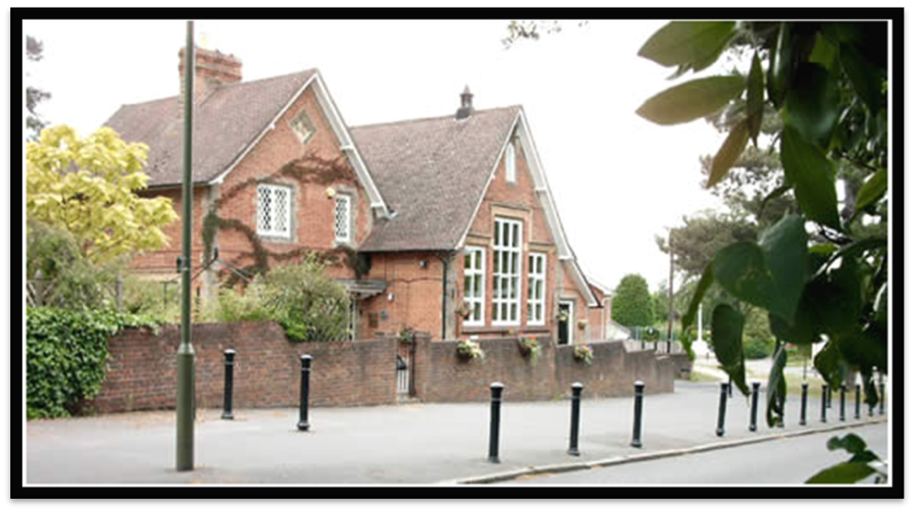
Welcome
Year 2 Parents Induction Meeting

Slide 2
The Vision for our School
That our children will be happy, secure and confident individuals that ask questions, challenge thinking and are motivated to learn. We will see active and engaged learners, experiencing a first-class education with a high achievement culture. Having Enquiry and Investigation and The Arts at the heart of the curriculum, we ensure that the children have constant opportunities to investigate and apply their knowledge, take risks and respond positively to challenge.
Quality teaching and provision will ensure that all children are inspired, engaged and motivated through purposeful learning and equipped with the skills to continue as life-long learners.
We have a ‘can do’ philosophy with adults and children, the cup is always half full not half empty. As adults we model this through everything we do, what we say and the way we act.
Kindness to yourself Kindness to others Kindness to the world

Slide 3
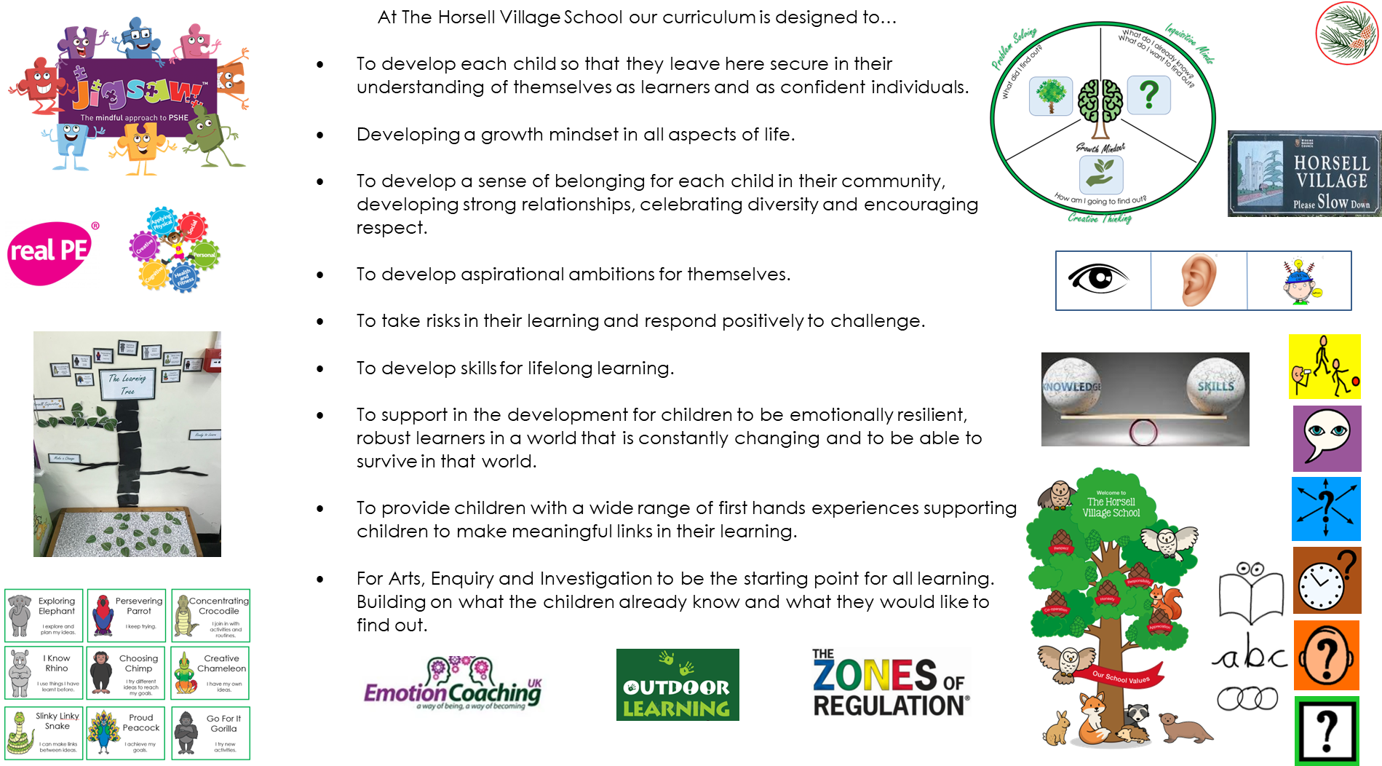
Curriculum Intent
Kindness to yourself Kindness to others Kindness to the world

Slide 4
Independence
Our focus in Year 2 is to develop independence by letting pupils take responsibility for themselves and their learning.
You can support this by encouraging them to take responsibility for their own belongings and know what they need to bring into school every day.
Kindness to yourself Kindness to others Kindness to the world

Slide 5
Uniform Expectations
We strive to encourage the children to be as proud of the school community as we are.
To support this we expect the children to come to school fully equipped for a day of learning.
Please make sure that they are wearing the correct uniform and that everything is clearly labelled.
Children are expected to bring their school book bag to school every day with them.
On occasions there are perfectly valid reasons for why your child may not come to school in the correct uniform. Please inform us if this is the case. If this continues you will receive a letter from the class teacher, followed by the year group leader and then a meeting with Mrs Reeve or Mrs Sharkey.
Kindness to yourself Kindness to others Kindness to the world

Slide 6
Things to Remember
-A waterproof must be in school every day regardless of the weather and a coat for winter months (hats/gloves for winter and sunhats and sun cream for spring/summer).
PE days:
Barn Owls – Monday and Wednesday
Tawny Owls – Tuesday and Wednesday
Snowy Owls – Wednesday and Thursday
-Fruit, filled water bottle every day.
-Reading book and Reading Diary
Kindness to yourself Kindness to others Kindness to the world

Slide 7
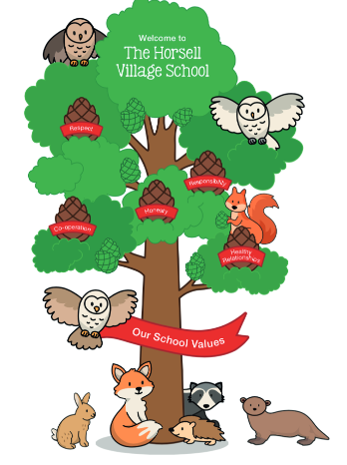
Our values are as follows:
Respect- Respect self, fellow pupils, teachers and other adults. Respect their own and others property. Respect the right that everyone can have their own thoughts, values and opinions.
Honesty- Be truthful to ourselves and others.
Co-operation – collaborate with our peers to gain the most from our learning, to learn from each other and utilising everyone’s skills.
Appreciation-to learn to build positive relationships with others by developing effective communication, trust and to understand the worth, quality and importance of something or someone.
Responsibility - To develop a sense of community, knowing that actions have an impact on them and others.
We explore the meaning of our school values through our daily reflections, classroom discussions, PSHE- Jigsaw and our behaviour and well-being approach
Kindness to yourself Kindness to others Kindness to the world

Slide 8
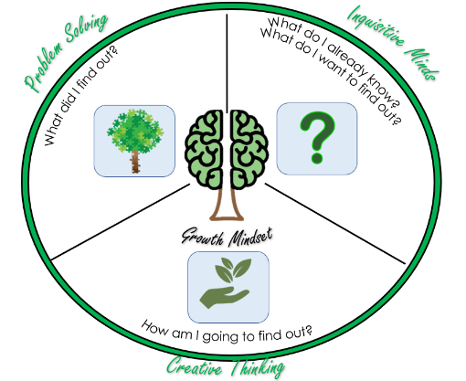
The Learning Cycle
The Learning Cycle has been devised
to help children take an increased
ownership over their learning and be able
to express their desires.
It is made up of 4 questions:
What do I already know?
What do I want to find out?
How will I find it out?
What did I find out?
These are used as a start and end to each
topic that is taught as well as in each
lesson.
Every lesson starts with a learning question
and the four questions from the
investigation cycle are to be used as an
assessment for learning tool throughout
the lesson but particularly at the start
and end of lessons.
Kindness to yourself Kindness to others Kindness to the world

Slide 9
The Learning Cycle
We want our children to leave The Horsell
Village School with three essential skills in
which will support them in becoming
life long learners.
- Inquisitive minds
Creative thinking
Problem solving
This is in conjunction with supporting children
to develop a growth mindset.
Kindness to yourself Kindness to others Kindness to the world

Slide 10
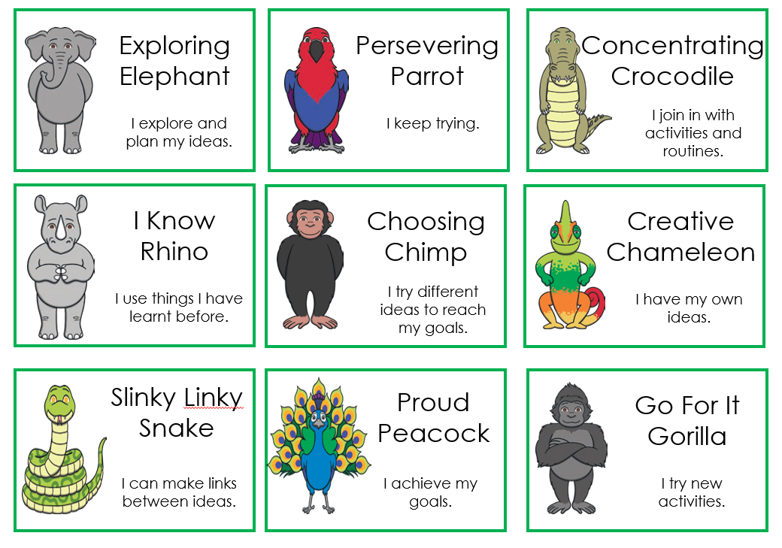
The characteristics of an effective learner
These form part of the essential
skills we want our children to be
able to do before they leave to
support in developing the skills
needed to be lifelong learners.
These are taught through
-Jigsaw PSHE lessons
-Reflections
-Modelled from adults
-discussed as the life skill associated
to particular learning activities.
-Form part of our behaviour and
well-being approach
Kindness to yourself Kindness to others Kindness to the world

Slide 11
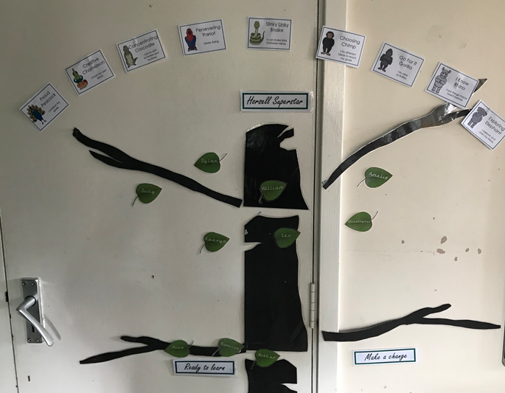
The Learning Tree
The learning tree is based around behaviours for learning as well as supporting children to identify when they are ready to learn.
Alongside the learning tree we teach the children a range of self regulation skills which enables them to be emotionally ready to learn.
Children start the day off the tree and place their leaf on the ‘Ready to learn’ branch when they identify themselves as emotionally ready to learn.
Individual support is provided and tailored to each child throughout the day if children identify themselves as not ready to learn.
Make a change branch is a discussion point for behaviours that are not
appropriate. At this stage adults use emotion coaching to identify the issue
and provide structured support to enable the child the time to self
regulate and return to ready to learn.
Horsell Superstar. We celebrate through identifying
moments related to our characteristics of an effective
learner. These may be different and are individualised
to each child.
Horsell Hero. Each day we celebrate an individuals
learning journey.
Kindness to yourself Kindness to others Kindness to the world

Slide 12
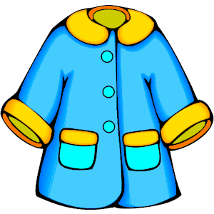


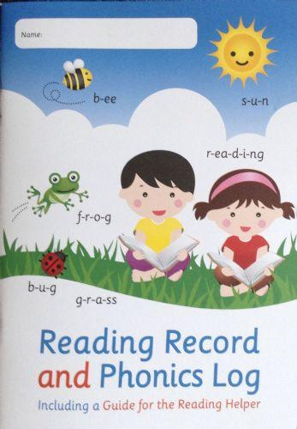
A typical day in Year 2
Routines
8.45 – 9.00 | Reading
9.00 - 9.15 | Reflections
9.15 – 9.35 | Spellings and phonics
9.40 -10.25 | Maths or English: outside/inside sessions
10.25– 10.45 | Fruit and milk time
10.45 – 11.35 | Maths or English: outside/inside sessions
11.40 – 12.00 | Reading Carousel
12.00 – 13.15 | Lunch
13.15 – 13.30 | Handwriting
13.30 – 14.25 | Foundation subjects
14.25 - 14.40 | Maths Mastery
14.40 – 15.00 | Tidy up and story time
Please send your child
with a coat everyday
regardless of weather.
Hats/gloves for winter
and sunhats and sun cream for spring/summer.
Please send your child
with a fruit snack and
a water bottle
everyday
Please make sure your
child’s reading diary is
in school daily.
Kindness to yourself Kindness to others Kindness to the world

Slide 13

Reading in school
Reading skills are taught daily.
All children will read in school at least once a week.
A reading session includes:
- word reading and definitions of new vocabulary.
- prediction skills based on the child’s knowledge of the text.
- comprehension including inference.
Reading at home
Try and read for 10-15 minutes daily- keep it fun.
Reading Records to be in school everyday.
Please sign and / or comment in your child’s reading record each time
you read. Please refer to our parents' guide to support.
Try and encourage your child to read a variety of different texts / genres
Keeping reading to your child- explore new vocabulary together and
model intonation.
Please ensure reading books are in school, available to change on a Tuesday and a Friday
should they need to.
Teachers will benchmark the children termly or when they feel they are ready to move up a
book band. Teachers will record this in the Reading Record when this has been completed.
The targets on the back of the Reading Record are designed to guide you in supporting your
child’s reading at home.
Kindness to yourself Kindness to others Kindness to the world

Slide 14
Phonics and spelling
Phonics and spelling is taught daily.
The children learn to apply their phonics knowledge in spelling unknown words.
The children learn spellings by understanding and applying common spelling rules.
Words and sounds of the week are displayed in all classrooms.
Every month, the weekly phonics and spelling focus will be updated on the website.
Kindness to yourself Kindness to others Kindness to the world

Slide 15
Maths
We base our maths learning on a teaching and learning approach called Maths Mastery.
Maths Mastery aims to develop a deep understanding of maths, so rather than memorising facts the children can apply their mathematical knowledge effectively in a range of problem solving scenarios.
We record our maths in a variety of different ways: in books, on whiteboards and through photographic evidence.
Numbots logins will be available during this term. These will be stuck into their Reading Records.
We recommend the White Rose 1 minute maths app.
Kindness to yourself Kindness to others Kindness to the world

Slide 16
-
How we will keep you informed of your child’s progress and
attainment:
Termly parent conferences to share your child’s learning, progress and attainment with you.
Be assured that if we consider that your child has any areas, which are of concern to us, you will have already been contacted by their class teacher in advance of parent conferences.
Kindness to yourself Kindness to others Kindness to the world

Slide 17
Our Curriculum : Topics
Autumn Term |  | Spring Term |  | Summer Term
1st Half | 2nd Half | 1st Half | 2nd Half | 1st Half | 2nd Half
Owls Master Makers | Bikes and Buses Christmas | The Living Rainforest | The Magic Library | Bright Lights, Big City | Pirates
Kindness to yourself Kindness to others Kindness to the world

Slide 18
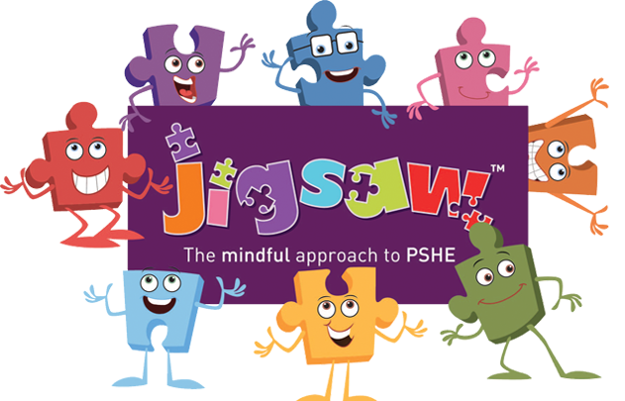
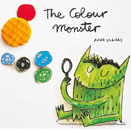
Mental Health and Well-being
The mental health and well being of our children is of utmost importance to us especially in light of current events.
In order to support the development of emotional literacy, social skills and spiritual well- being, we follow the Jigsaw scheme of work which is a mindful approach to the teaching of P.S.H.E.
Weekly lessons include:
Breathing and calming techniques
Opportunities to reflect on and share thoughts, ideas and opinions
Discussions around British Values
In addition, as part of our, ’Good to be Me’ afternoons,
We introduce emotions and associated vocabulary using the book, ‘The Colour Monsters’.
Kindness to yourself Kindness to others Kindness to the world

Slide 19



We
Feedback Symbols
We use a range of symbols when giving feedback during our learning:
Target Met
Next steps
Hard work
Improvement
Good presentation
Kindness to yourself Kindness to others Kindness to the world

